Slide 1
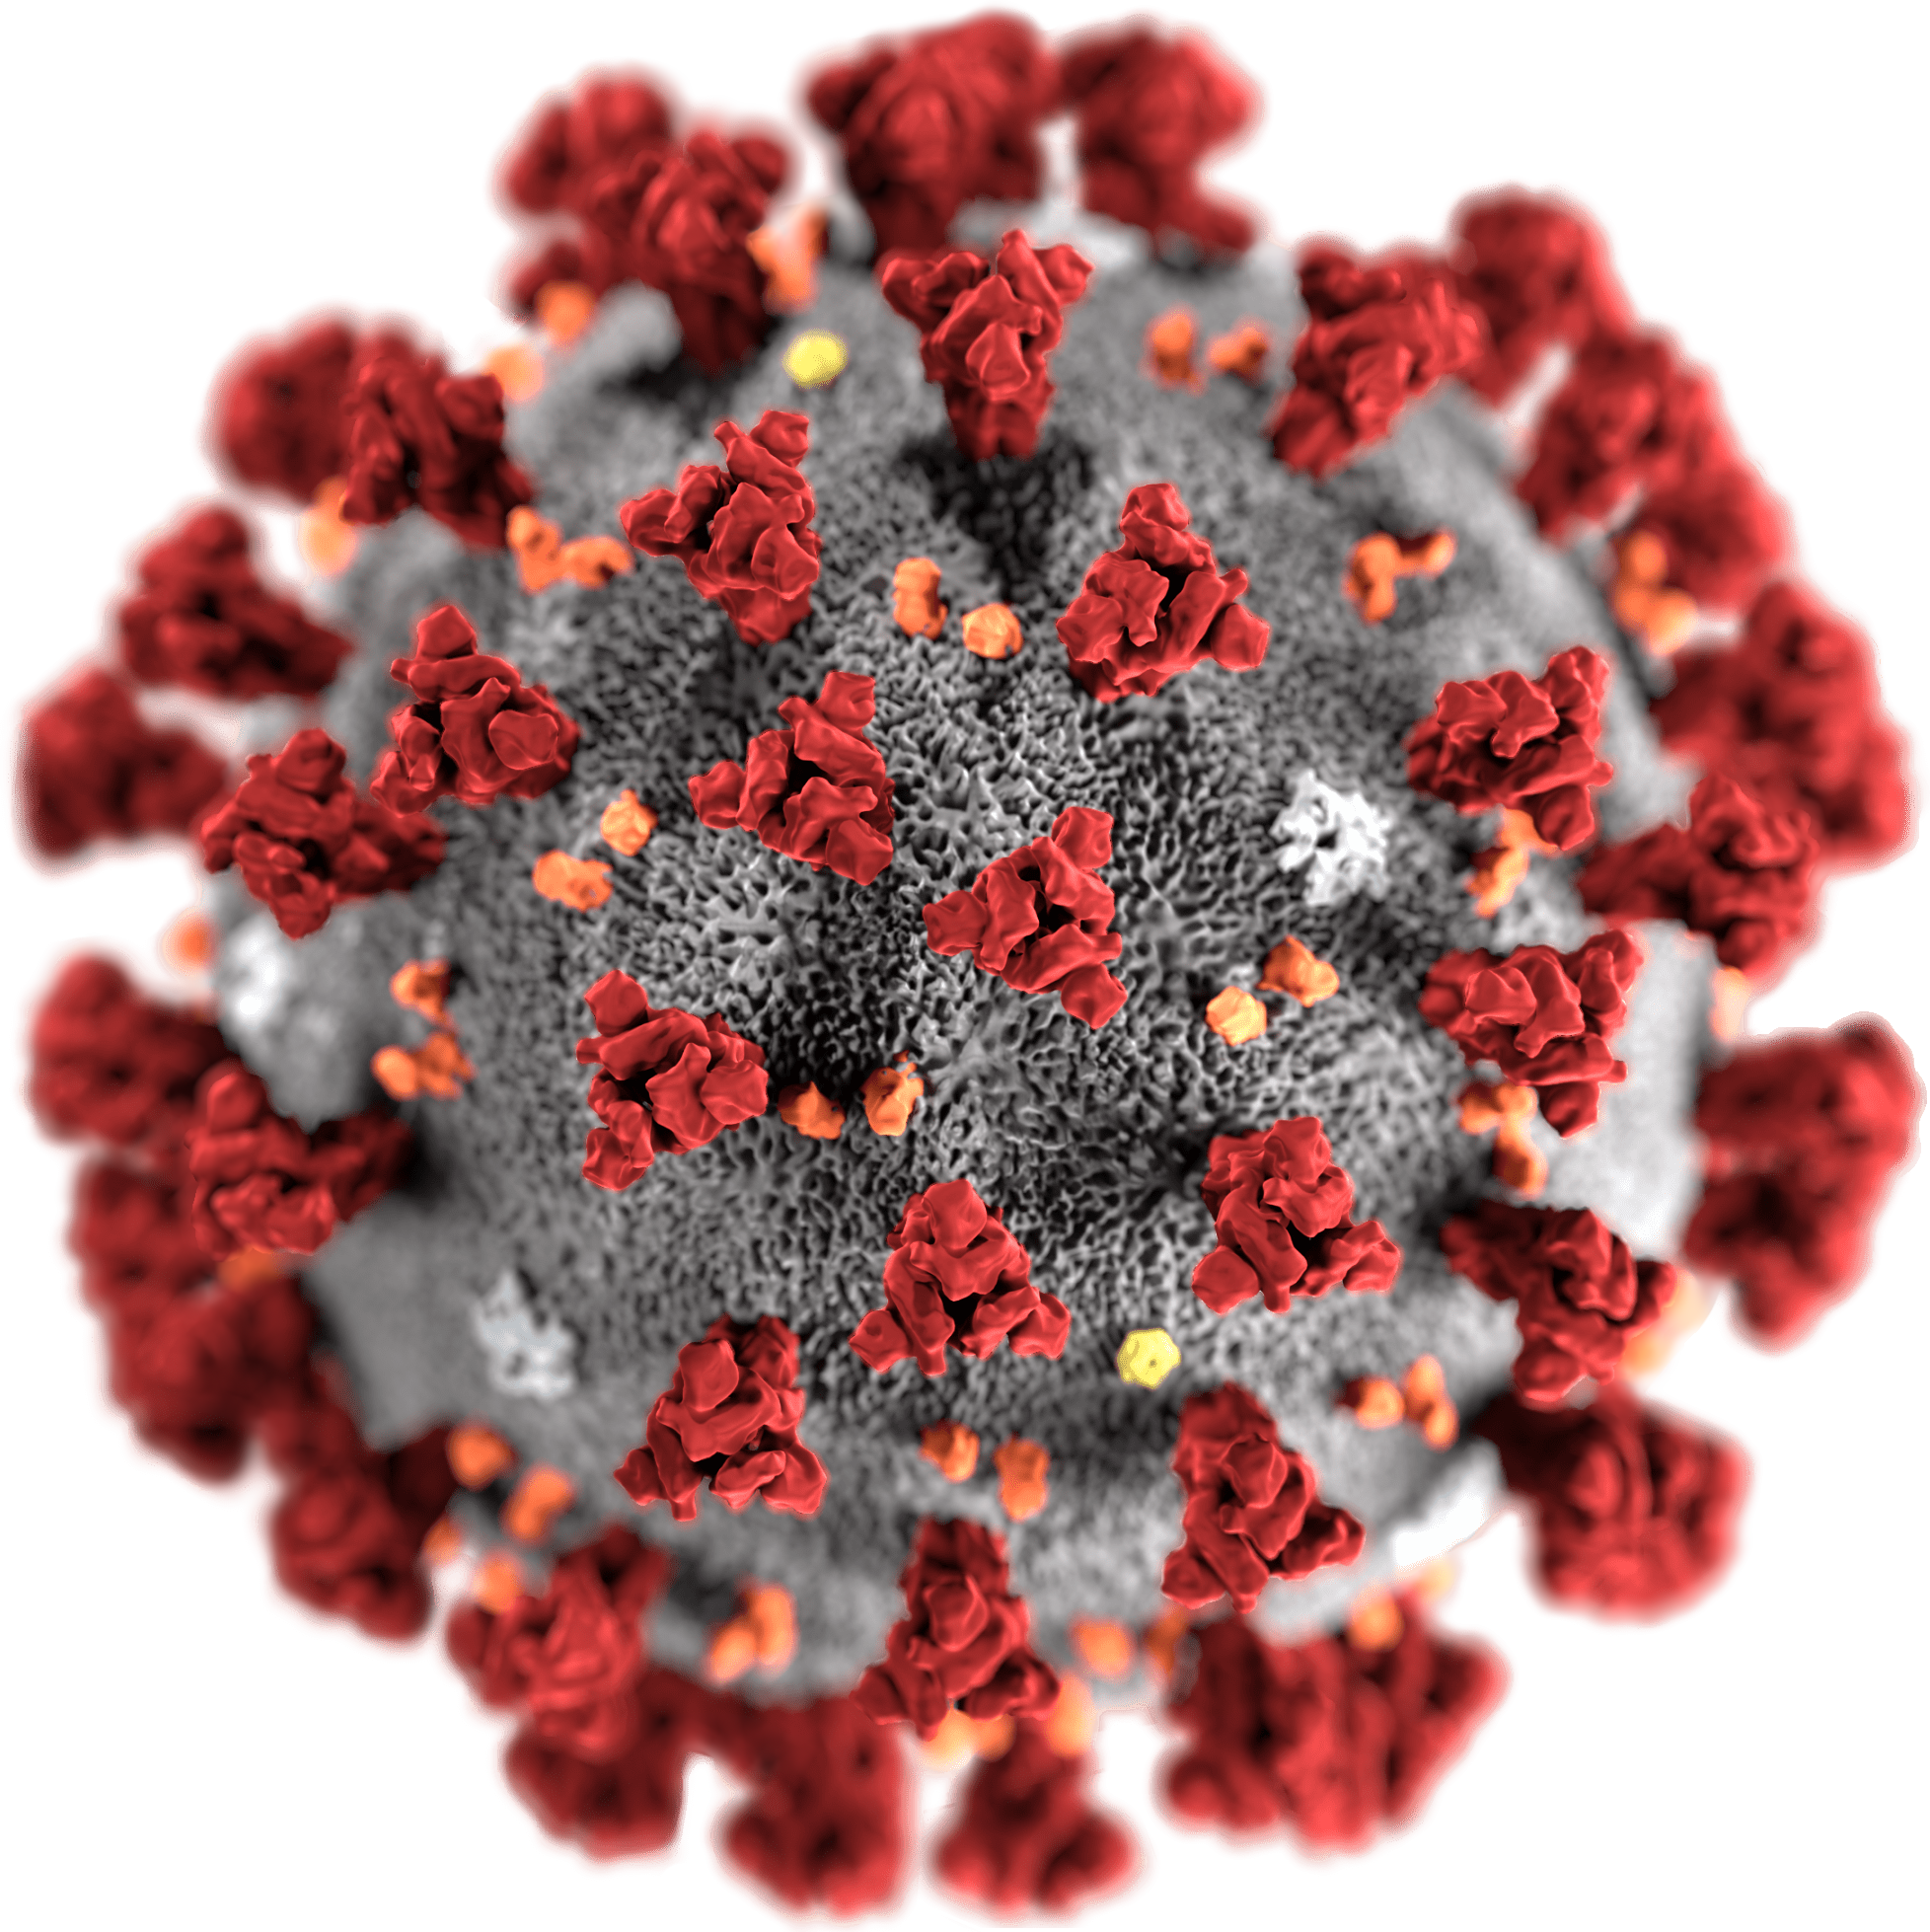
PROJECT ON :
ANALYSIS OF COVID-19 INDIA
PRESENTED BY:
ADIL ADNAN SIDDIQUI
SANDEEP PHATAK
RAHUL MUNGALI
ANUJ KUMAR

Slide 2
Action Plan
Phase 1
Phase 2
Phase 3
Phase 4
Analyze problem statement
Brain Storming
Python & SQL Query
Insights
Analyze the given problem statement
Brain storming on the given problem & check the multiple table for possible solution
Figuring out the data with the help of python & SQL
Get the output based on the respective query

Slide 3





Adil Adnan S
Sandeep Phatak
Rahul Mungali
Anuj Kumar

Slide 4
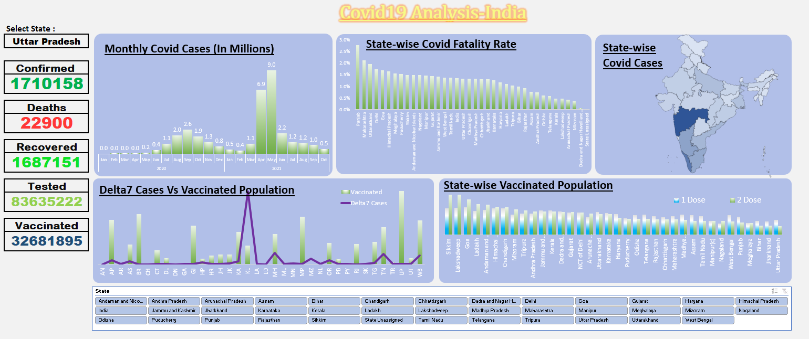
DASHBOARD

Slide 9
TR | Category
0 – 0.05 | A
0.05 – 0.1 | B
0.1 – 0.3 | C
0.3 – 0.5 | D

Slide 10
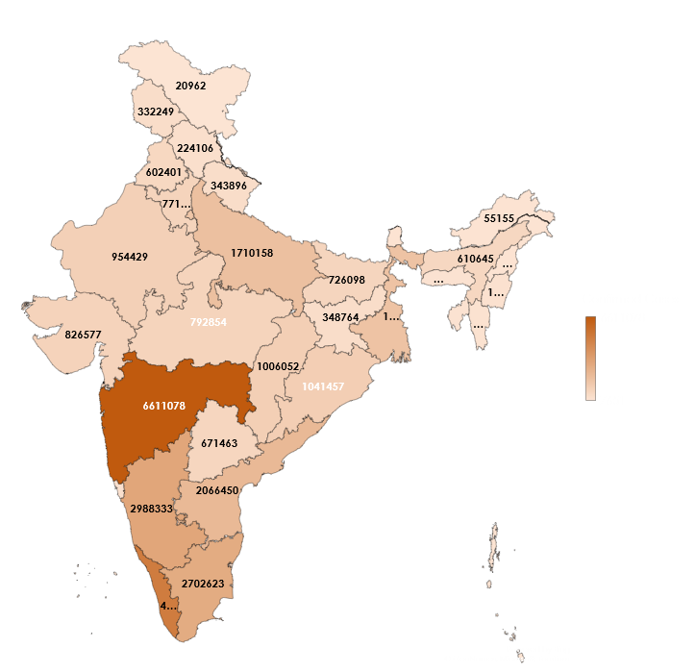
State-wise Confirmed Cases

Slide 11
Insights:
The Trend in covid cases shows rapid rise in covid cases after relaxation in lockdown.
Also, High rise in covid cases observed during April & May- 2021, due to Delta variant.
Most number of covid positive cases registered in Maharashtra whereas, Highest Fatality rate of 2.77% observed in Punjab State.
Delta7 Cases were highest in Kerala where, lesser vaccination is observed.
Till 31St oct 2021, Highest percentage of 5.57% population is vaccinated in Sikkim state.
When Districts were categorized based on Testing Ratio, maximum deaths were reported in states with highest testing ratio.

Slide 12
THANK YOU!

